Slide 1

Project-P165- Hotel Rating Classification
Mentor: Mr Adhvaith
Group 4:
Group Members:
Mr. Dharmendra Vinod Makwana
Sonali Sahu
Mr. Sonu Kumar
Ms Pranjal Sharma
Mr.Rajesh Mukund Bharati
Mr. Akshay Arvind Ukey
Mr . Tejas RAdhvaith

Slide 2

Objective:
This is a Classification Project, our goal is to examine how travellers are communicating their positive and negative experiences in online platforms for staying in a specific hotel and major objective is what are the attributes that travellers are considering while selecting a hotel.
With this manager can understand which elements of their hotel influence more in forming a positive review or improves hotel brand image.

Slide 3
Project Flow
Understanding The Business Objective
Data Collection
EDA
Modelling
Model Evaluation
Model Deployment

Slide 4
EXPLORATORY DATA ANALYSIS

Slide 5
Data Set Details:
Shape of the dataset is 20491 Rows ,2 Columns.
The two features are “Reviews” and “Ratings”.
Reviews Feature contain categorical values and it is a “object” Datatype.
Ratings Feature contain numerical values and it is a “float64” Datatype.
There are No null or missing values.
No outliers in data.

Slide 6
DATA VISUALIZATION

Slide 7
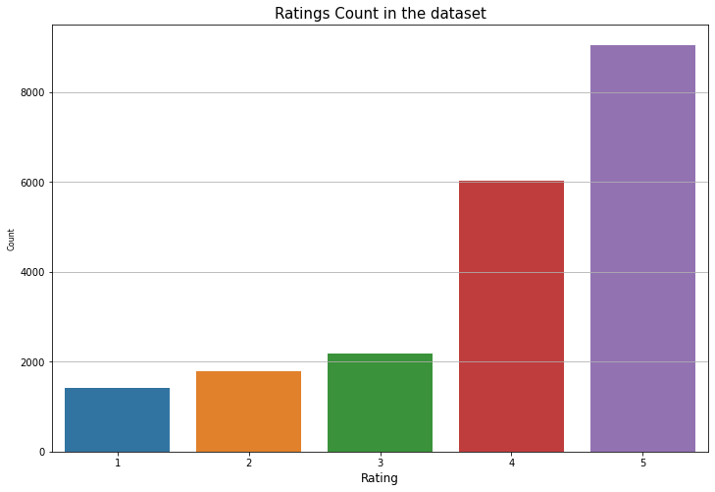
HISTOGRAM
Here it is found that the given Data Set have more reviews with Rating 5 as compared with the reviews with rest of the ratings.

Slide 8
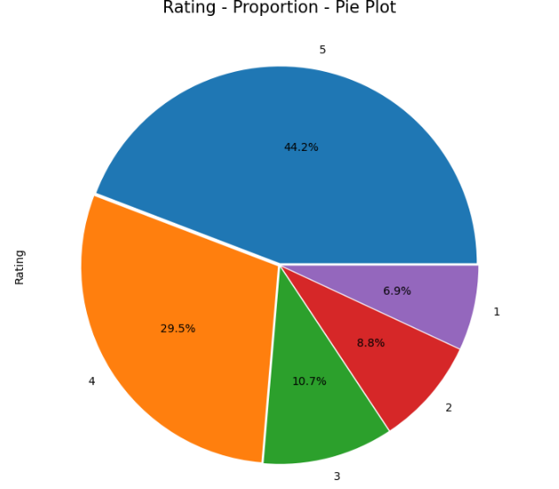
Pie Plot
By looking in to the plots plotted it is found that the major portion reviews in the Data Set are Good Reviews (i.e., 4 & 5).

Slide 9
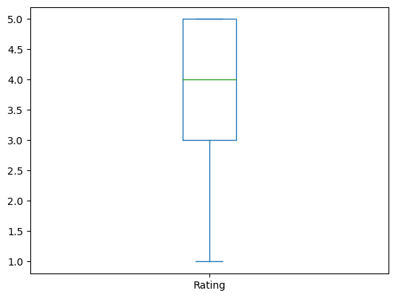
BOX PLOT
The Box Plot Shows there are no Outliers in the given Data Set and
It is Positively Skewed.

Slide 10
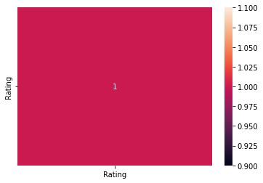
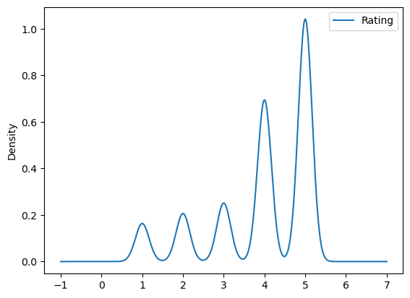
DENSITY PLOT AND HEAT MAP FOR CORRELATION

Slide 11
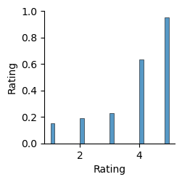
Pair Plot
Value Counts:
Rating_1 :- 1421 (7%)
Rating_2 :- 1793 (9%)
Rating_3 :- 2184 (11%)
Rating_4 :- 6039 (29%)
Rating_5 :- 9054 (44%)

Slide 12
Pre-processing steps:
Cleaning the data by removing punctuations,Hashtags,RH,urls,tags from the data
Removing Stop words.
Reducing words to their root form through Lemmatization.
Finding Polarity and subjectivity of the words to understand the sentiment behind it.

Slide 13
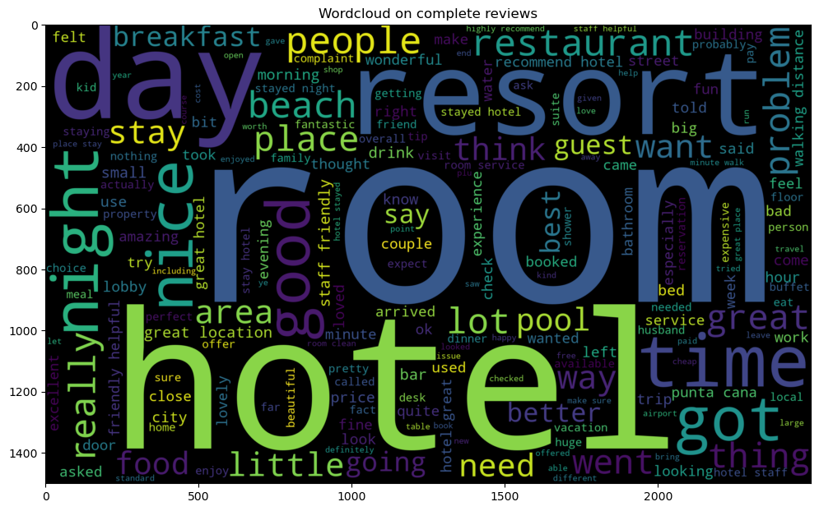
Word Cloud
Most of the words are indeed related to the customer experience with the hotel stay: great, nice, awesome, good, expensive etc.
Some words are related to the hotels: hotel, rooms, parking etc.

Slide 14
n-gram analysis
Bigram rating counts for 4 and 5
For rating 4
[('great location', 845),
('staff friendly', 763),
('punta cana', 565),
('walking distance', 528),
('friendly helpful', 503),
('staff helpful', 416),
('good value', 414),
('stayed nights', 409),
('minute walk', 402),
('great time', 401)]
For rating 5
[('great location', 1014),
('staff friendly', 1013),
('friendly helpful', 777),
('highly recommend', 736),
('walking distance', 735),
('punta cana', 603),
('staff helpful', 540),
('place stay', 540),
('stayed nights', 511),
('minute walk', 511)]

Slide 15
Tri gram rating counts for 4 and 5
For rating 4
[('staff friendly helpful', 298),
('good value money', 125),
('10 minute walk', 99),
('great place stay', 98),
('flat screen tv', 89),
('easy walking distance', 85),
('la carte restaurants', 85),
('king size bed', 73),
('staff helpful friendly', 68),
('free internet access', 68)]
For rating 5
[('staff friendly helpful', 403),
('great place stay', 169),
('flat screen tv', 151),
('king size bed', 114),
('10 minute walk', 114),
('staff helpful friendly', 104),
('great location great', 100),
('free internet access', 100),
('easy walking distance', 96),
('staff extremely helpful', 94)]

Slide 16
Check for common words in highest rated reviews
{'great location',
'punta cana',
'staff friendly',
'stayed nights',
'walking distance’}
Check for common words in least rated reviews
{'punta cana', 'san juan'}

Slide 17
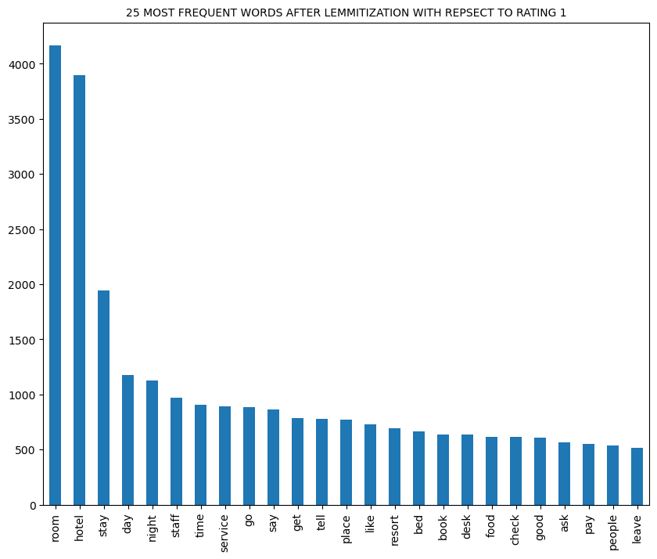

Slide 18
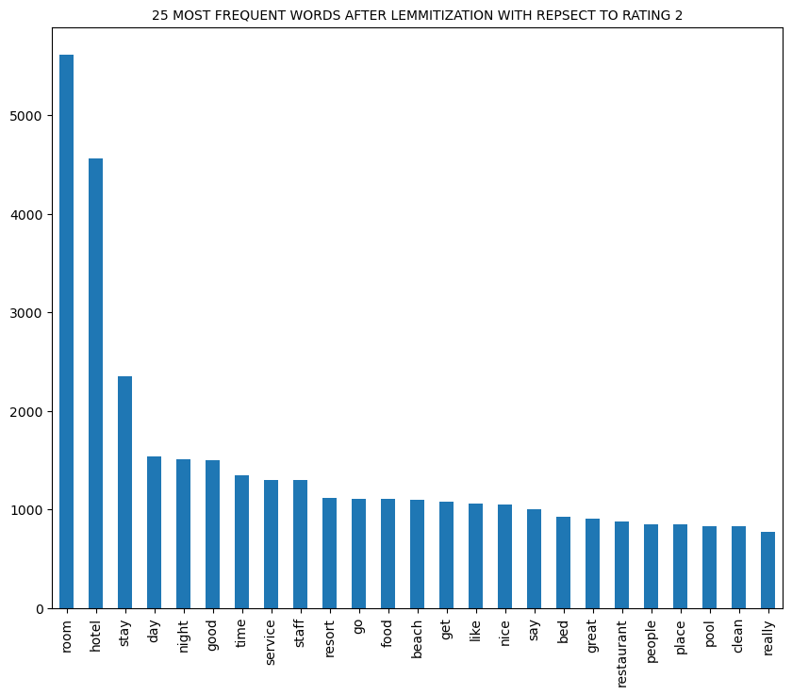

Slide 19
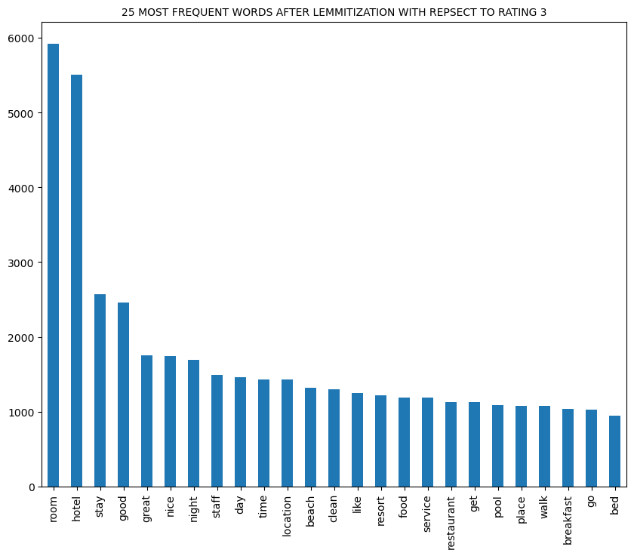

Slide 20
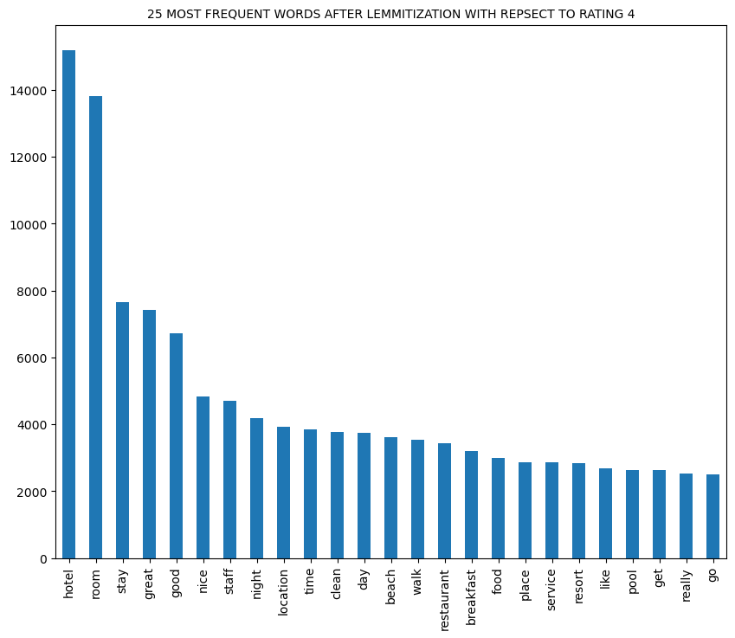

Slide 21
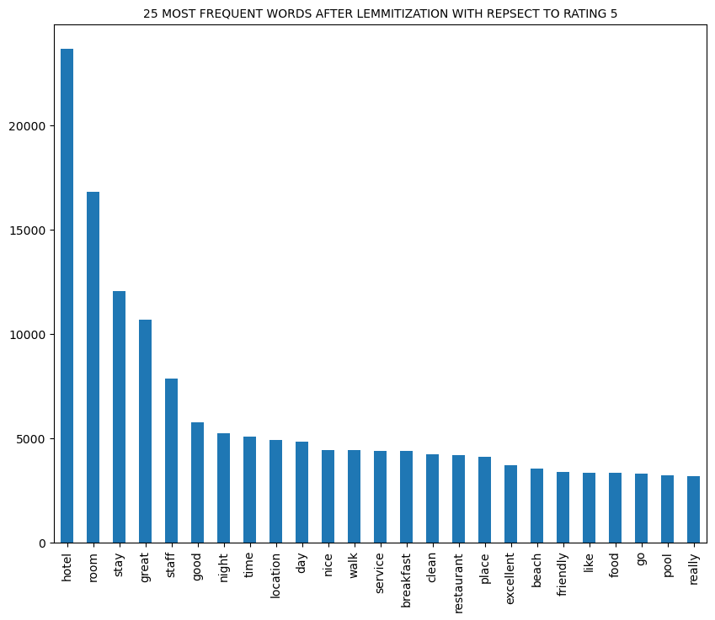

Slide 22
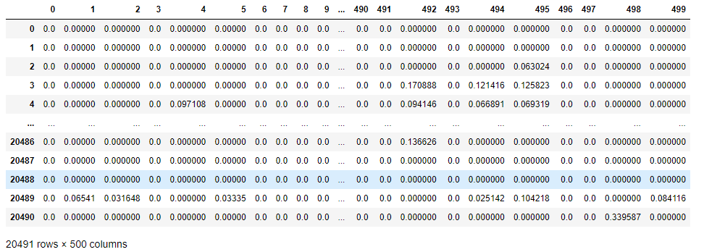
Using TF-IDF Data is converted into structured numerical format.

Slide 23
MODEL BUILDING

Slide 24
0.97
0.97
1.Logistic Regression:
Accuracy of train dataset is 0.974
Accuracy of test dataset is 0.964
2.Random Forest Classifier:
Accuracy of train dataset is 1.0
Accuracy of test dataset is 0.95
3.Naivebayes:
Accuracy of train dataset is 0.949
Accuracy of test dataset is 0.955

Slide 25
4. K-Nearest Algorithm
Accuracy of train dataset is 0.943
Accuracy of test dataset is 0.950
5.SVM:
Accuracy of train dataset is 0.997
Accuracy of test dataset is 0.959
6. Adaboost:
Accuracy of train dataset is 0.949
Accuracy of test dataset is 0.955

Slide 26
Deployment

Slide 27
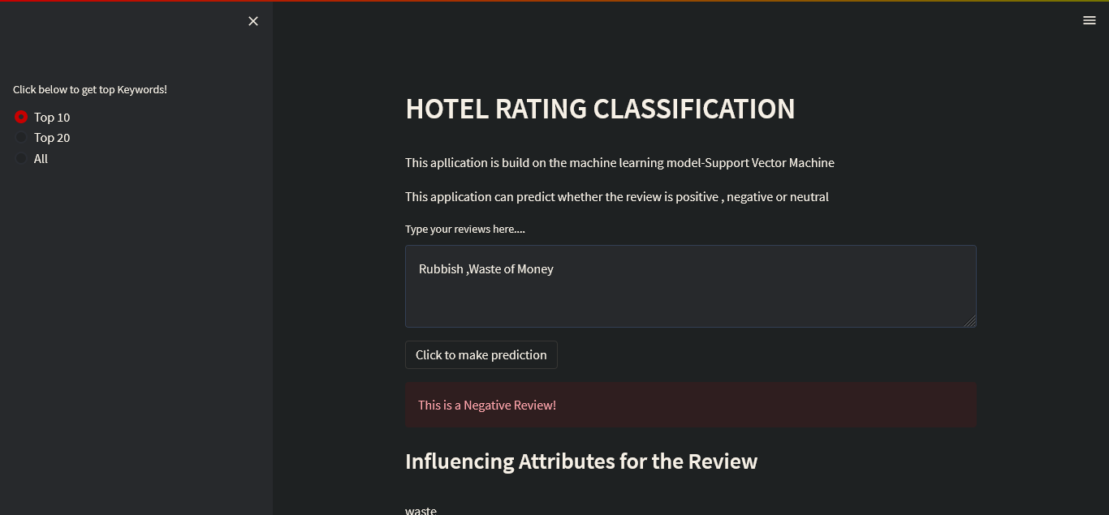

Slide 28
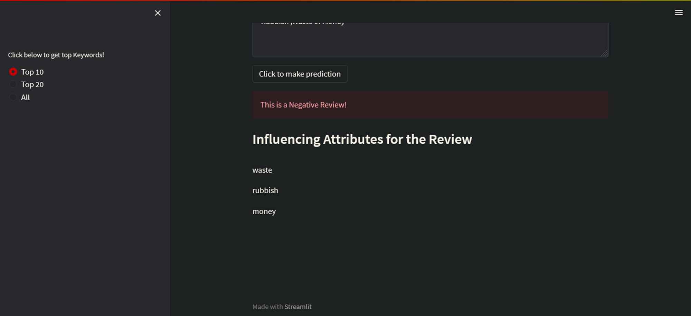

Slide 29
THANK YOU

